Slide 1
Procura + Lisbon conference
13 March 2024
Ivo Locatelli – Senior Expert DG GROW Unit C2 Public Procurement policy

Slide 2
Public Buyers Community Platform
https://public-buyers-community.ec.europa.eu/

Slide 3
Keep in touch
Strategic Procurement
NEWSLETTER
GROW-Innovationprocurement@ec.europa.eu
EC DG GROW YouTube Channel
Agents of Innovation Procurement
Actors for Social Impact Procurement

Slide 4
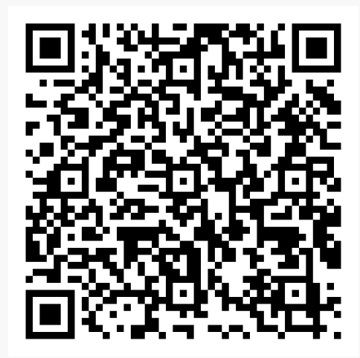
Interested:
bigbuyers@
eurocities.eu

Slide 5
Thank you for your attention!
© European Union 2020
Unless otherwise noted the reuse of this presentation is authorised under the CC BY 4.0 license. For any use or reproduction of elements that are not owned by the EU, permission may need to be sought directly from the respective right holders.
Notes:
Update/add/delete parts of the copy right notice where appropriate.
More information: https://myintracomm.ec.europa.eu/corp/intellectual-property/Documents/2019_Reuse-guidelines%28CC-BY%29.pdf

